Slide 1



Noida Institute of Engineering and Technology, Greater Noida
TABLEAU
Unit: 3
Business Intelligence and Data Visualization
(ACSDS0602)
Mona Devi
Assistant professor
CSE-DS
Course Details ( B Tech 6th Sem)

Slide 2
Evaluation Scheme
B. Tech (DS)
6th Semester
Professional Course
BUSINESS INTELLIGENCE AND DATA VISUALIZATION
L T P | Credits
3 – 0– 0 | 3

Slide 3
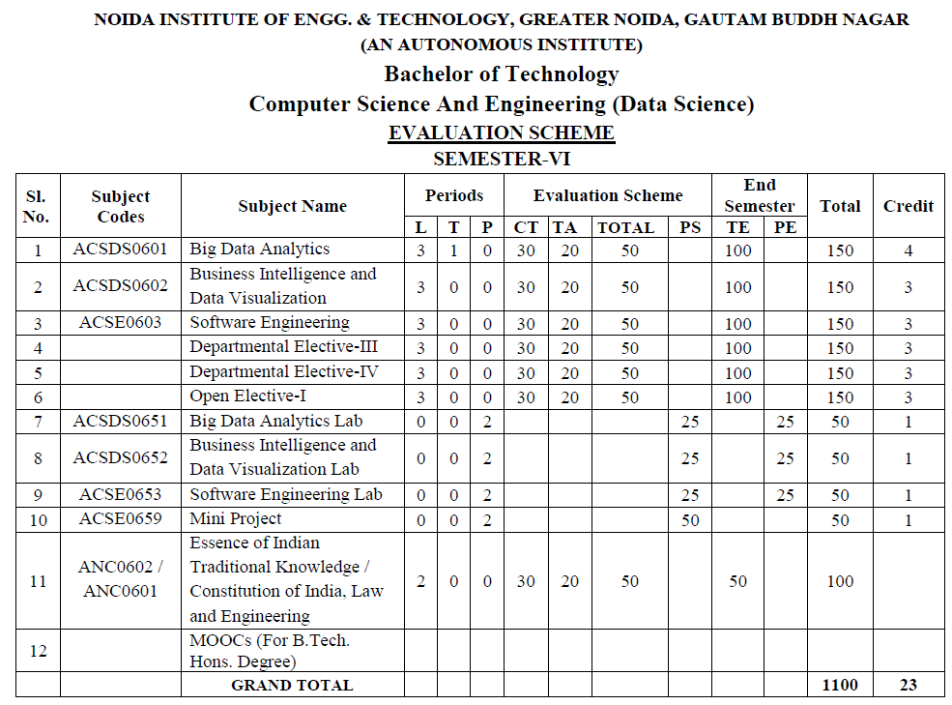
Evaluation Scheme

Slide 4

Course objective
B. TECH. (DS)
Course code |  | L T P 3 0 0 | Credits 3
Course title | Business intelligence and Data visualization
Course objective:
This course covers fundamental concepts of Business Intelligence tools, techniques, components and its future. As well as a bit more formal understanding of data visualization concepts and techniques. The underlying theme in the course is feature of Tableau, its capabilities.

Slide 5
Course Syllabus
Course Contents / Syllabus
UNIT-III | TABLEAU | 8 Hours
Introductions and overview: What Tableau can and cannot do well, Debug and troubleshoot installation and configuration of the software. Creating Your First visualization: Getting started with Tableau Software, Using Data file formats, connecting your Data to Tableau, creating basic charts (line, bar charts, Tree maps), Using the Show me panel Tableau Calculations: Overview of SUM, AVR, and Aggregate features Creating custom calculations and fields, Applying new data calculations to your visualization. Formatting Visualizations: Formatting Tools and Menus, formatting specific parts of the view, Editing and Formatting Axes.

Slide 6
Course Outcomes
Course outcomes : After completion of this course students will be able to
CO 1 | Apply quantitative modelling and data analysis techniques to the solution of real-world business problems | K1, K2
CO 2 | Understand the importance of data visualization and the design and use of many visual components | K2
CO 3 | Understand as products integrate defining various analytical process flow. | K2
CO4 | Learn the basics of troubleshooting and creating charts using various formatting tools. | K3, K4
CO 5 | Learn basics of structuring data and creating dashboard stories adding interactivity dashboard stories. | K5, K6

Slide 7
Content
Debug and troubleshoot installation and configuration of tableau.
Connecting data file formats to tableau
Creating different charts
Perform basic tableau calculations
Formatting visualizations

Slide 8
Course Objective
This course introduces data visualization theories, techniques, and tools particularly for analyzing and presenting business data. Students will design, develop, and evaluate effective visualizations and dashboards, using various development tools.
This course focuses on how business intelligence in Tableau uses business analytics tools that make it easy to combine data from multiple sources, analyze and visualize information. It helps trainees in making more informed and better decisions to guide the business. After the completion of the course trainee will be through with all the concepts of business intelligence and Tableau.
The objective of this course is to assist the folks in running a business strategically. One of the main objectives of this training is to train you on all the concepts that are related to business intelligence and Tableau. The purpose of the Business Intelligence using Tableau training program is to support better business decision-making. Topics like BI – Business Intelligence, Business Intelligence with Tableau, are covered in the training program.

Slide 9
Course Outcome
Business intelligence (BI) is essentially the collection of tools and processes that are used to gather data and turn it into meaningful information that people can use to make better decisions. Using Excel, you can create powerful reports, scorecards, and dashboards. You can bring data into Excel, sort, and organize data, and use it to create reports and scorecards. You can also use powerful analytic capabilities in Excel to visualize and explore data. Through these tutorials, we are going to understand business intelligence and data visualization using the Tableau tool. This training will help you learn about.
This course introduces data visualization theories, techniques, and tools particularly for analyzing and presenting business data. Students will design, develop, and evaluate effective visualizations and dashboards, using various development tools.

Slide 10
CO-PO and PSO Mapping
 | PO1 | PO2 | PO3 | PO4 | PO5 | PO6 | PO7 | PO8 | PO9 | PO10 | PO11 | PO12 | PSO1 | PSO2 | PSO3
CO1 | 2 | 1 | 1 |  | 2 | 2 |  |  |  | 1 |  | 1 | 1 | 1
CO2 | 1 | 2 | 2 | 1 | 3 | 1 |  | 1 | 1 | 2 | 1 | 2 | 2 | 2 | 1
CO3 | 1 | 2 | 1 | 1 | 1 | 2 |  |  |  | 1 | 2 | 2 |  | 1 | 1
CO4 | 1 | 2 |  |  | 1 | 1 |  |  | 1 | 1 | 1 | 1 | 1 | 2 | 2
CO5 | 1 | 3 | 1 | 1 | 1 |  | 1 | 1 |  |  |  | 2 |  | 1 | 2
AVG | 1.2 | 2 | 1.25 | 1 | 1.6 | 1.5 | 1 | 1 | 1 | 1.25 | 1.33 | 1.6 | 1.33 | 1.4 | 1.5

Slide 11
Prerequisite and Recap
Discussion about Business Intelligence.
Basic Knowledge Of Business Intelligence.
Knowledge about Data mart Data warehouse.

Slide 12
Youtube & NPTEL Video Links and Online Courses Details
Youtube/other Video Links
Introduction to Business Intelligence - YouTube
Business Intelligence Tutorial - YouTube
What Is Power BI? | Introduction To Microsoft Power BI | Power BI Training | Edureka - YouTube
https://www.tableau.com/academic/students
Top 10 Data Visualization Tools in 2020 | Best Tools for Data Visualization | Edureka - YouTube
Learn Data Visualization Using Tableau | Tableau Tutorial | Tableau | Edureka Live - YouTube

Slide 13
What Tableau can and cannot do well
Tableau is a visual analytics engine that makes it easier to create interactive visual analytics in the form of dashboards. These dashboards make it easier for non-technical analysts and end users to convert data into understandable, interactive graphics.
Tableau saves time when updating daily and weekly reports that currently reside in spreadsheets. That’s because Tableau separates the data layer from the presentation layer and makes updating a spreadsheet data source a trivial append to the bottom of your source spreadsheet.
Tableau reduces the burden on your IT team by enabling end users to conduct meaningful analysis, make useful discoveries and build interactive dashboards with much less technical support versus traditional (developer-centric) tools.
Tableau is a way to expand the frequency, depth and variety of data used in your organization. Most importantly, Tableau’s visual analytical capabilities are easy to use and present large and granular data sets more effectively than legacy reporting tools and spreadsheet reports.
Ms. Mona Devi ACSDS0602 BI Unit 3

Slide 14
What Tableau can and cannot do well
Tableau is not a data creation tool. You can make new data in Tableau using forecasts, trend lines, reference lines, calculated values and table calculations. However, if data creation or modeling of novel scenarios is your primary need (building a budget for example), use a spreadsheet.
Tableau is not an ETL engine for cleaning-up bad data, although it can be very helpful in identifying missing or erroneous data in your existing data sources. Visualizing data via time series, bar charts, scatter plots or in maps highlights errors and outliers more effectively than grids of data in a spreadsheet.
Tableau is not a table-production tool. It can be used to create text tables, but if you are asking for help to create your 500-row, 32-column grid, you are using Tableau the wrong way.
Ms. Mona Devi ACSDS0602 BI Unit 3

Slide 15
Advantages of tableau
Data visualization
Quickly Create Interactive visualizations: Using drag-n-drop functionalities of Tableau, the user can create a very interactive visual within minutes.
Ease of Implementation: There are many different types of visualization options available in Tableau which enhance the user experience.
Tableau can handle large amounts of data: Tableau can handle millions of rows of data with ease. Different types of visualization can be created with a large amount of data without impacting the performance of the dashboards.
5. Use of other scripting languages in Tableau: To avoid the performance issues and to do complex table calculations in Tableau, users can incorporate Python or R.
6. Mobile Support and Responsive Dashboard: Tableau Dashboard has a great reporting feature that allows you to customize dashboard specifically for a certain device such as a mobile phone or laptop.
7. Tableau Company Strategy: Tableau has done a great job climb its way to the top of data visualization tools.
Ms. Mona Devi ACSDS0602 BI Unit 3

Slide 16
Disadvantages to Tableau
Scheduling or notification of reports: Tableau does not provide the feature of automatic refreshing of the reports with the help of scheduling.
No Custom Visual Imports: Tableau is not a complete open tool.
Custom formatting in Tableau: Tableau’s conditional formatting and limited 16 column table displays are pain points for users.
Static and single value parameters
5. Screen Resolution on Tableau Dashboards: The layout of the dashboards gets disturbed if the tableau developer’s screen resolution is different from end user’s screen resolution
6. Limited Data Preprocessing. Tableau is strictly a visualization tool. Tableau Desktop allows you do to very basic preprocessing. This includes joining and blending data.
7. Scaling and Pricing for Enterprise: This is the biggest issue with Tableau, it’s a very expensive product to scale across a large organization.
Ms. Mona Devi ACSDS0602 BI Unit 3

Slide 17
Getting started with Tableau Software
STEPS
Step 1: Connect to your data
Learn all about the Start page and how to connect to your data.
Step 2: Drag and drop to take a first look
Get to know the Tableau workspace, learn the language of Tableau, and start examining your data.
Step 3: Focus your results
Ask deeper questions and use additional tools to refine your views and gain insights about your data.
Step 4: Explore your data geographically
Learn how to plot your data on a map to see if you can spot any trends.
Step 5: Drill down into the details
Drill down into the details of your data and learn how to create a Top filter.
Step 6: Build a dashboard to show your insights
Learn how to build and format a dashboard to display the visualizations you created.
Step 7: Build a story to present
Learn how to build and format a story to present your findings.
Step 8: Share your findings
Share your findings with your organization on Tableau Server or Tableau Online, or share them with the world on Tableau Public.
Ms. Mona Devi ACSDS0602 BI Unit 3

Slide 18
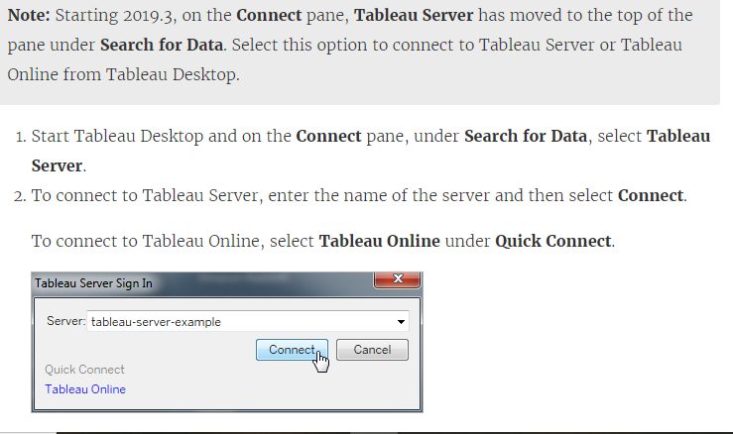
Connect from Tableau Desktop
Ms. Mona Devi ACSDS0602 BI Unit 3

Slide 19
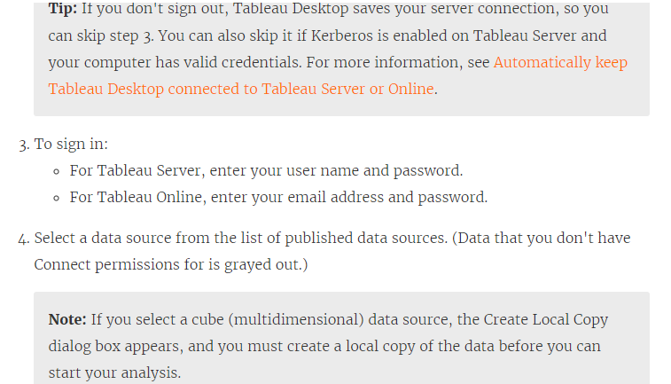
Connect from Tableau Desktop
Ms. Mona Devi ACSDS0602 BI Unit 3

Slide 20
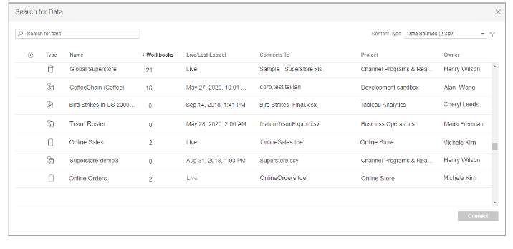
Connect from Tableau Desktop
Search for data by using the Search box. Or you can sort the list by selecting the column headers. Column headers that support sorting are underlined when you hover over the header. You can also select the filter icon to filter data by Connection Type and by Certified.
Ms. Mona Devi ACSDS0602 BI Unit 3

Slide 21
Connect from Tableau Desktop
In addition to connecting to data sources, when you have the Data Management Add-on, you can connect to data using a virtual connection. When Tableau Catalog is enabled you can also connect to databases, files, and tables.
You can select from Data Sources, Virtual Connections, Databases and Files, or Tables to search for data.
You can filter assets by several options including Tag, Data Quality Warning, Certified, and more.
Note: From the Search for Data results, you can make a connection with a subset of the data connectors that Tableau Desktop supports. If a data source, database, file, or table is grayed out, you can't connect from Tableau Server or Tableau Online. You can, however, connect from the Tableau Desktop Connect pane, if you have the correct permissions.
After you select the data you want to connect to, click Connect.
Select the sheet tab to start your analysis.
Data sources published to Tableau Server or Tableau Online are shown in the Data pane with a Tableau icon.
You might want to download a local copy of the data source so that you can, for example, work offline or make changes to a data source without modifying the original. To download a local copy, on the Data menu, select the data source, and then select Create Local Copy. A duplicate of the data source is added to the Data pane.
Ms. Mona Devi ACSDS0602 BI Unit 3

Slide 22
What is Tableau Treemap?
The most widely used interactive Data Visualization tool is Tableau. It has a large number of charts to help you easily and effectively explore your data. Data is represented by Rectangle Boxes in Tableau Treemap. Each rectangle box can be determined by any of your Dimension members, and the box size can be determined by the Measure value. Tableau Treemaps are extremely useful for displaying the most complex data set information in a small data region.
The Tableau Treemap was designed to display hierarchical data, but it is now also used to display part-to-whole relationships. Dimensions are used to define the Tableau Treemap’s structure, while Measures are used to define the size and color of the individual rectangles. Treemaps are simple Data Visualization that can present information in a visually appealing manner. When you need to show cumulative totals for the working data, the Tableau Treemap chart is the way to go. When making the chart, you can include labels such as date, time, name, and budget.
Ms. Mona Devi ACSDS0602 BI Unit 3

Slide 23
What is Tableau Treemap?
A Tableau Treemap’s fundamental components are:
Mark type:Automatic or Square
Color:Dimension or Measure
SizeMeasure
Label or Detail:Dimension(s)
When there are many components in a whole, a Tableau Treemap is used to show how they fit together. A rectangular area divided into smaller rectangles to represent sub-categories is typically (but not always) used for the arrangement. The size of these subcategory rectangles is a numerical value. The small rectangles are usually logically grouped into a different categorical family and colored to indicate a key data attribute.
The Tableau Treemap has some drawbacks, such as the fact that it offers very limited customization options to the user and is inefficient at representing data ranges. It’s a good idea to give the Treemap in Tableau proper labels, colors, sizes, and naming conventions so that the visualizations are more meaningful.
Ms. Mona Devi ACSDS0602 BI Unit 3

Slide 24
How to Build a Tableau Treemap?
Here you’ll be making a Treemap Chart showing no profit and no sales in specific years, along with the profit ratios that go with them.
Step 1: You need to connect the TABLEAU application to a dataset as users:
The ‘Superstore‘ dataset, which comes preinstalled with the application, can be seen in the main section (black area). To create a Treemap Chart, you will use this dataset.
Step 2: When you click on the Sample Superstore dataset, you’ll see the screen below:
Ms. Mona Devi ACSDS0602 BI Unit 3

Slide 25
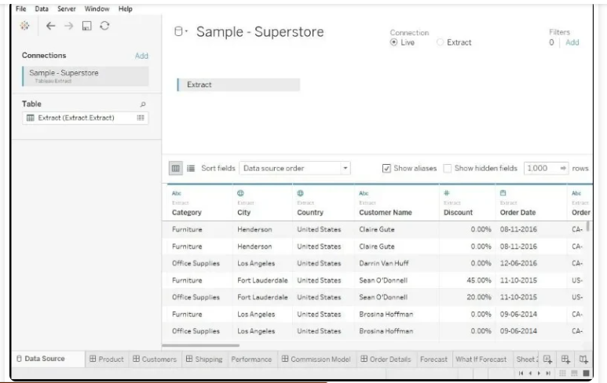
How to Build a Tableau Treemap?
Ms. Mona Devi ACSDS0602 BI Unit 3

Slide 26
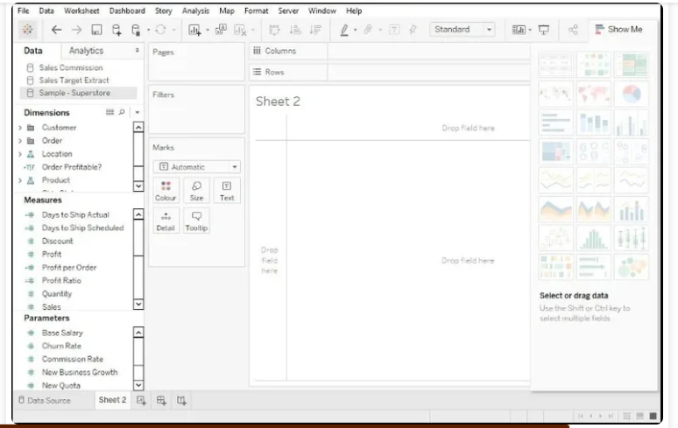
How to Build a Tableau Treemap?
The content of the data set is listed in multiple tabs at the bottom of the screen, indicating that Sample Superstore is fully loaded. This is a type of working data reference chart.
Step 3: Now you’ll create your own Treemap Chart; when you create a new worksheet on the dashboard, you’ll see something like this:
Ms. Mona Devi ACSDS0602 BI Unit 3

Slide 27
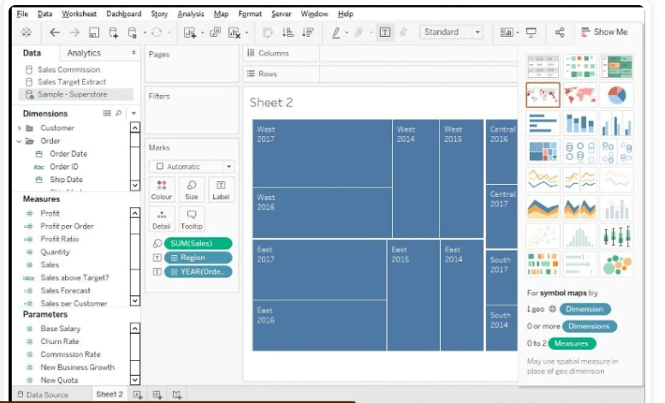
How to Build a Tableau Treemap?
Only two-dimensional data is considered within a Treemap Chart. On the left-hand side of the screen, you can see the ‘Dimension,‘ ‘Measures,’ and ‘Parameters’ sections. All of these contain various types of data or data measurement techniques.
Step 4: Then, from the Dimension and Measure section, you drag and drop data. The actual chart-making process starts from here. You want the YEAR and REGIONAL information to be at the top of your chart. So you select ‘Text’ and drag the Region and Year of Order dates to it.
Step 5: Drag and drop ‘Sales’ into the ‘Size’ section to add the Sales information to the chart (present under the Marks) as shown below:
Ms. Mona Devi ACSDS0602 BI Unit 3

Slide 28
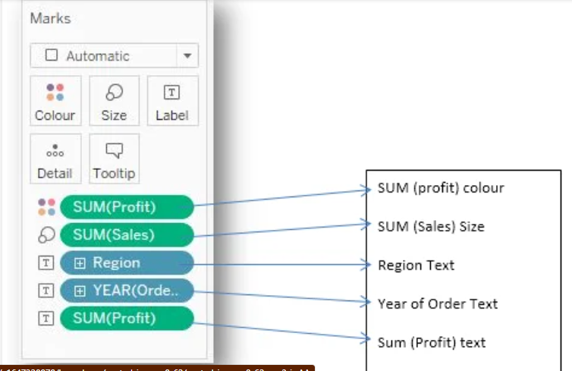
How to Build a Tableau Treemap?
Step 6: With this, you’ll be able to add the term ‘Profit’ to the chart, which will display the profits earned as a percentage of total sales in a given region over time.
Step 7: This is the basic structure of a Treemap Chart, but you want to sort the profit by color. Drag and drop the ‘Profit’ mark to the ‘Color’ marks section to accomplish this. Examine the image below:
Step 8: The information in the Marks section specifies the types of details that will be reflected. Take a look at the illustration below:
Ms. Mona Devi ACSDS0602 BI Unit 3

Slide 29
How to Build a Tableau bar chart?
A bar chart represents data in rectangular bars with the length of the bar proportional to the value of the variable. Tableau automatically produces a bar chart when you drag a dimension to the Row shelf and measure to the Column shelf. We can also use the bar chart option present in the Show Me button. If the data is not appropriate for bar chart, then this option will be automatically greyed out.
In Tableau, various types of bar charts can be created by using a dimension and a measure.
Simple Bar Chart
From the Sample-Superstore, choose the dimension, take profit to the columns shelf and Sub-Category to the rows shelf. It automatically produces a horizontal bar chart as shown in the following screenshot. In case, it does not, you can choose the chart type from the Show Me tool to get the following result.
Ms. Mona Devi ACSDS0602 BI Unit 3

Slide 30
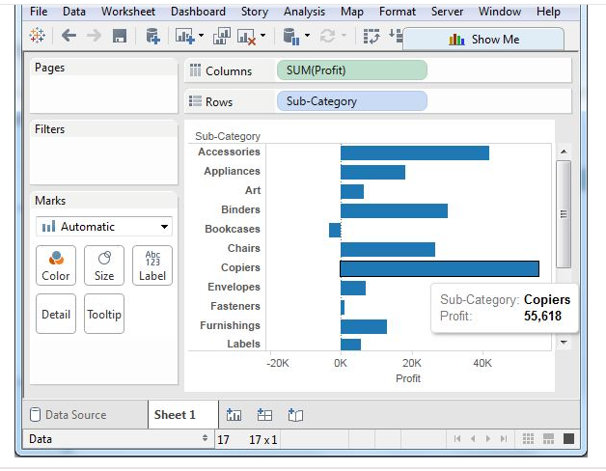
How to Build a Tableau bar chart?
Ms. Mona Devi ACSDS0602 BI Unit 3

Slide 31
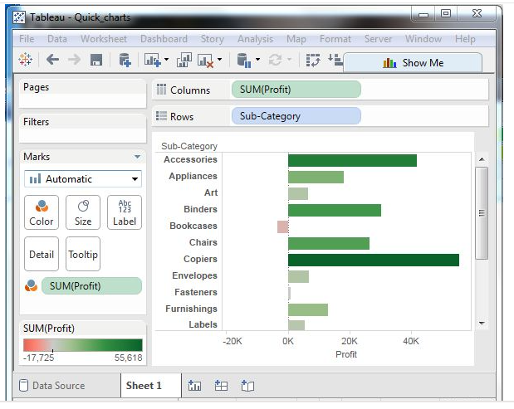
How to Build a Tableau bar chart?
Bar Chart with Color Range
You can apply colors to the bars based on their ranges. The longer bars get darker shades and the smaller bars get the lighter shades. To do this, drag the profit field to the color palette under the Marks Pane. Also note that, it produces a different color for negative bars.
Ms. Mona Devi ACSDS0602 BI Unit 3

Slide 32
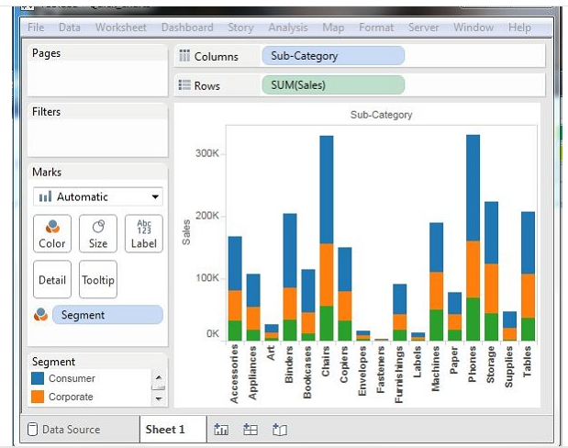
How to Build a Tableau bar chart?
Stacked Bar Chart
You can add another dimension to the above bar chart to produce a stacked bar chart, which shows different colors in each bar. Drag the dimension field named segment to the Marks pane and drop it in colors. The following chart appears which shows the distribution of each segment in each bar.
Ms. Mona Devi ACSDS0602 BI Unit 3

Slide 33
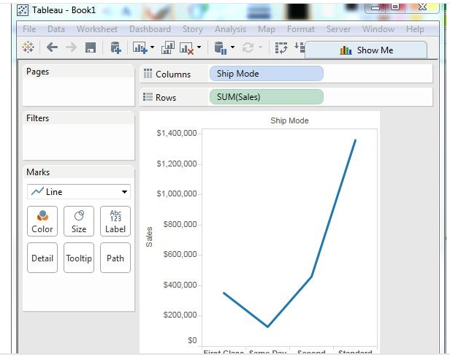
How to Build a Tableau line chart?
In a line chart, a measure and a dimension are taken along the two axes of the chart area. The pair of values for each observation becomes a point and the joining of all these points create a line showing the variation or relationship between the dimensions and measures chosen.
Simple Line Chart
Choose one dimension and one measure to create a simple line chart. Drag the dimension Ship Mode to Columns Shelf and Sales to the Rows shelf. Choose the Line chart from the Marks card. You will get the following line chart, which shows the variation of Sales for different Ship modes.
Ms. Mona Devi ACSDS0602 BI Unit 3

Slide 34
What is an aggregate function?
Data is generated and analyzed at many different levels of granularity. Granularity is the level of detail of the data. For example, when looking at graduation data, granularity would describe whether a row in the data set represents a single person or the graduating class of a university.
But what if you wanted to take a data set of student information and identify a value for the graduating class as a whole—that is, decrease the granularity? Aggregation and granularity are complementary concepts. Aggregation is a mathematical operation that takes multiple values and returns a single value: operations like sum, average, count, or minimum. This changes the data to a lower granularity (aka a higher level of detail).
Ms. Mona Devi ACSDS0602 BI Unit 3

Slide 35
How aggregations are constructed
If your analysis requires aggregation, you need to consider two things:
How the outcome will be structured: Consider the new granularity—that is, what a row represents. If we’re looking at voter turnout, is it at the level of political party? Political party and voting district? Political party, voting district, age bracket, and gender? The field or fields that determine what makes up a row are the grouping fields (in Tableau Prep).
How we aggregate multiple values down to a single value: For example, are we summing the number of shirts of each color for a total number of shirts? Are we taking the maximum hourly temperature reading over the course of a day and providing the daily max? Are we doing a count distinct of IP addresses to hit a webpage and measuring the unique page views?
Numeric fields can be aggregated by various mathematical operations depending on the desired outcome. See the full list here. This includes:
Sum
Average or Median
Count or Count Distinct
Minimum or Maximum
Or various statistical operations can be performed such as variance or standard deviation.
Dates and text-based fields can be aggregated as count, count distinct, maximum, or minimum (for text, maximum and minimum are based on sort order).
Ms. Mona Devi ACSDS0602 BI Unit 3

Slide 36
Combining aggregated data
Oftentimes, data at different levels of granularity needs to be combined. For example, to give a comprehensive view for geospatial analysis, city-level data often needs to be combined with country-level data.
Joins are a common way to combine data. But if we perform a join across different levels of granularity, we will inevitably introduce issues of data replication or loss.
Let's say we have two tables of data, one with the observed number of picnic blankets in various colors per year, and another with the number of ants seen in a year. Here’s how the data looks:
Ms. Mona Devi ACSDS0602 BI Unit 3

Slide 37
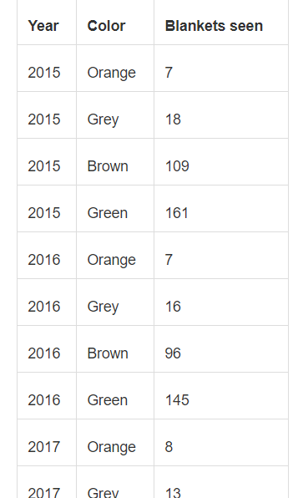
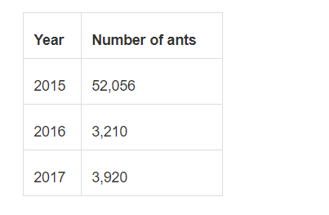
Combining aggregated data
Ms. Mona Devi ACSDS0602 BI Unit 3

Slide 38
Combining aggregated data
If we join the tables, we’ll either:
Repeat the number of ants seen for every blanket color OR
Lose the color-level information
If we don't like either of the options above, we can choose to not join the tables and perform the analyses with the two tables independently.
1. Repeat the number of ants seen for every blanket color: If we were to join these tables, we could simply replicate the number of ants seen in a given year for each row in the blanket table.
Structuring the data this way isn’t perfect because we have the number of ants repeated for each year. This means that, in analysis, if we simply brought out Year and Number of Ants (as a sum) we’d quadruple the number of ants. To get around this, we’d need to use a different aggregation (such as average or min), or use an LOD expression to fix the number of ants per year, thus preventing accidental over-counting: {FIXED [Year] : MIN([Number of ants])}.
Ms. Mona Devi ACSDS0602 BI Unit 3

Slide 39
Combining aggregated data
Data structured like the table above is also potentially misleading because it would be easy to assume that, as there were 18 grey blankets in 2015, there were 52,056 ants seen on those 18 grey blankets. Most data sets with this appearance are structured so each row is an independent observation, which could lead to misinterpretation if that’s not the case.
2. Lose the color-level information: To get around that, we can aggregate the number of blankets, dropping the color information before the join, resulting in a single data set with yearly information about ants and blankets.
Now the data is neither replicated nor likely to be misinterpreted, but we’ve lost the color breakdown entirely. Hint: Remember that changes in the level of detail can only ever be towards more aggregation, never more granularity. If we do this, we lose the color information entirely.
Ms. Mona Devi ACSDS0602 BI Unit 3

Slide 40
Format Text
Whether you're changing the font size, position, color, or direction, Tableau provides a wide range of customization options for your text.
When you make formatting changes at this level, they apply only to the view you're working on. See Format at the Workbook Level for how to make changes that apply to every view in your workbook.
To access worksheet-level format settings, select the Format menu, then choose the part of the view, such as Font, or Border, that you want to format.

Slide 41
Format fonts and Format text alignment
Select Format > Font . A Format Font control pane will open. This control pane will let you customize the text in the view.
Tableau uses visual best practices to determine how text is aligned in a view, but you can also customize text. For example, you can change the direction of header text so that it is horizontal (default) instead of vertical (up).
To format the text alignment, select Format > Alignment to open the text alignment pane.

Slide 42
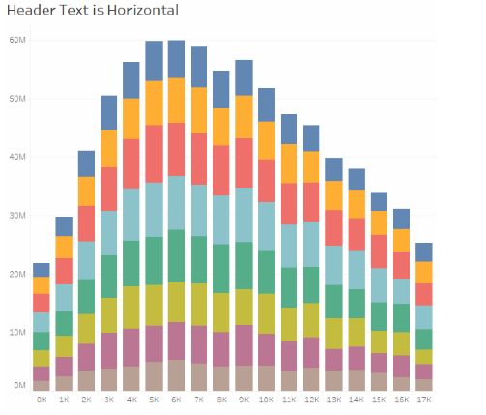
Format text alignment

Slide 43
Format text alignment
For each text area you can specify the following alignment options:
Horizontal - Controls whether text aligns to the left, right, or center.
Vertical Alignment - Controls whether text aligns at the top, middle, or bottom.
Direction - Rotates text so that it runs horizontally (default), top-to-bottom (up), or bottom-to-top (down).
Wrap - Controls whether long headers wrap to the next line or are abbreviated. It does not control text marks in the visualization.

Slide 44
Format tooltips
Tooltips are details that appear when you rest the pointer over one or more marks in the view. Tooltips also offer convenient tools to quickly filter or remove a selection, select marks that have the same value or view underlying data. You can edit the tooltip to include both static and dynamic text. You can also modify which fields are included in the automatic tooltip.
To edit a tooltip:
Select Worksheet > Tooltip. Tooltips are specified for each sheet and can be formatted using the formatting tools along the top of the Edit Tooltip dialog box. Use the Insert menu at the top of the dialog box to add dynamic text such as field values, sheet properties, and more.

Slide 45
Format tooltips
Use the formatting tools along the top of the Edit Tooltip dialog box.
(Optional) Use the Insert drop-down list at the top of the dialog box to add dynamic text such as field values, sheet properties, and more.
The All Fields option on the Insert menu adds all field names and values that are used in the view. Inserting the All Fields parameter updates the tooltip as you change the view. You can also use the All Fields option to exclude fields.
(Optional) Select the Include command buttons option to show filtering and view data options in the tooltip. For example, including command buttons will add Keep Only, Exclude, and View Data buttons to the bottom of the tooltip. These command buttons are available both in Tableau Desktop and when the view is published to the web or viewed on a mobile device.
(Optional) Select the Allow selection by category check box to select marks in a view that have the same value by clicking on a discrete field in a tooltip. For more information see Tooltips.

Slide 46
Edit worksheet titles, captions, and legend titles
Do one of the following:
On Tableau Server or Tableau Online web editing, double click the item you want to change.
On Tableau Desktop, Right-click (control-click on Mac) the item you want to change and select Edit <item>, for example, Edit Title.
On a worksheet, hover on the title, click the drop-down arrow on the right-hand side and select Edit Title or Edit Caption from the context menu.
In the Edit dialog box, modify the text and format the font, size, style, color, and alignment. Use the Insert menu to add dynamic text such as sheet properties and field values. Click OK.
To reset the title back to the default, click Reset.

Slide 47
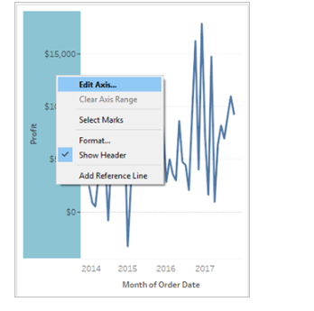
Edit an axis range
To edit an axis range, double-click the axis that you want to edit.

Slide 48
Edit an axis range
Note: In Tableau Desktop, you can right-click (control-click on Mac) the axis, and then select Edit Axis. In web authoring, you can click the arrow button on an axis, and then select Edit Axis.
When you select an axis, the marks associated with the axis are not selected so that you can edit and format the axis without modifying the marks.
To select the marks associated with the axis, right-click the axis and select Select Marks. You can also select each mark individually.

Slide 49
Daily Quiz
Default aggregation used for tree map__________
Avg
Count
Sum
Countd
The best feature Tableau are except_____________-
Collaboration of data
Data Blending
Real time analysis
Data is more small and fit

Slide 50
Daily Quiz
How do you find the field is discrete in Tableau ?
Green color
# symbol
Blue color
None
What percent of total profits do the top 10 customer by Sales represent?
5.03%
17.54%
16.26%
3.50%

Slide 51
Daily Quiz
Which of the following is not a Trend Line model ?
Linear Trend Line
Binomial Trend Line
Exponential Trend Line
Logarithmic Trend Line
Where can we apply global filters?
Dashboards
Stories
Sheets
All of the above

Slide 52
Daily Quiz
The Tableau Product Suite consists of____________-
Tableau Desktop ,Tableau Public, Tableau Online, Tableau Server, Tableau Measure
Tableau Desktop, Tableau Public ,Tableau Online ,Tableau Server ,Tableau Reader
Tableau Desktop ,Tableau Public ,Tableau Dimension ,Tableau Server, Tableau Reader
Tableau Desktop ,Tableau Public ,Tableau Online, Tableau Server ,Tableau Organic
Tableau File Extension is_______________
twbx
twby
twbw
twbz

Slide 53
Daily Quiz
The possible cause of the data not being updated is:
Data Extract needs an update
The data source configuration of Data Extract needs to be refreshed
Services on Data Extrac are not running
The workers of Data Extrac are taking a timeout
State the type of join is used in blending?
Left join
Full join
Right join
Inner join

Slide 54
Weekly Assignment
1. State the difference between Traditional BI Tools and Tableau?
2. Define Tableau?
3. Explain the different Tableau Products and state the latest version of Tableau?
4. State the different connections you can make with your dataset?
5. Describe shelves?
6. Define sets?

Slide 55
Weekly Assignment
1. State Tableau Data Server?
2. Define Tableau Data Engine?
3. Sate the different filters in Tableau and how are they different from each other?
4. Describe the steps to create a calculated field in Tableau?
5. Sate dual axis?
6. Explain the difference between a tree map and heat map?
7. Define disaggregation and aggregation of data?
8. Name the components of a Dashboard.
9. Sate TDE file?

Slide 56
Summary
This unit provides us the basic concept of tableau
How to install it
How to ceate visualization in tableau
Performing basic calculations
Formatting tools

Slide 57

Old Question Papers

Slide 58
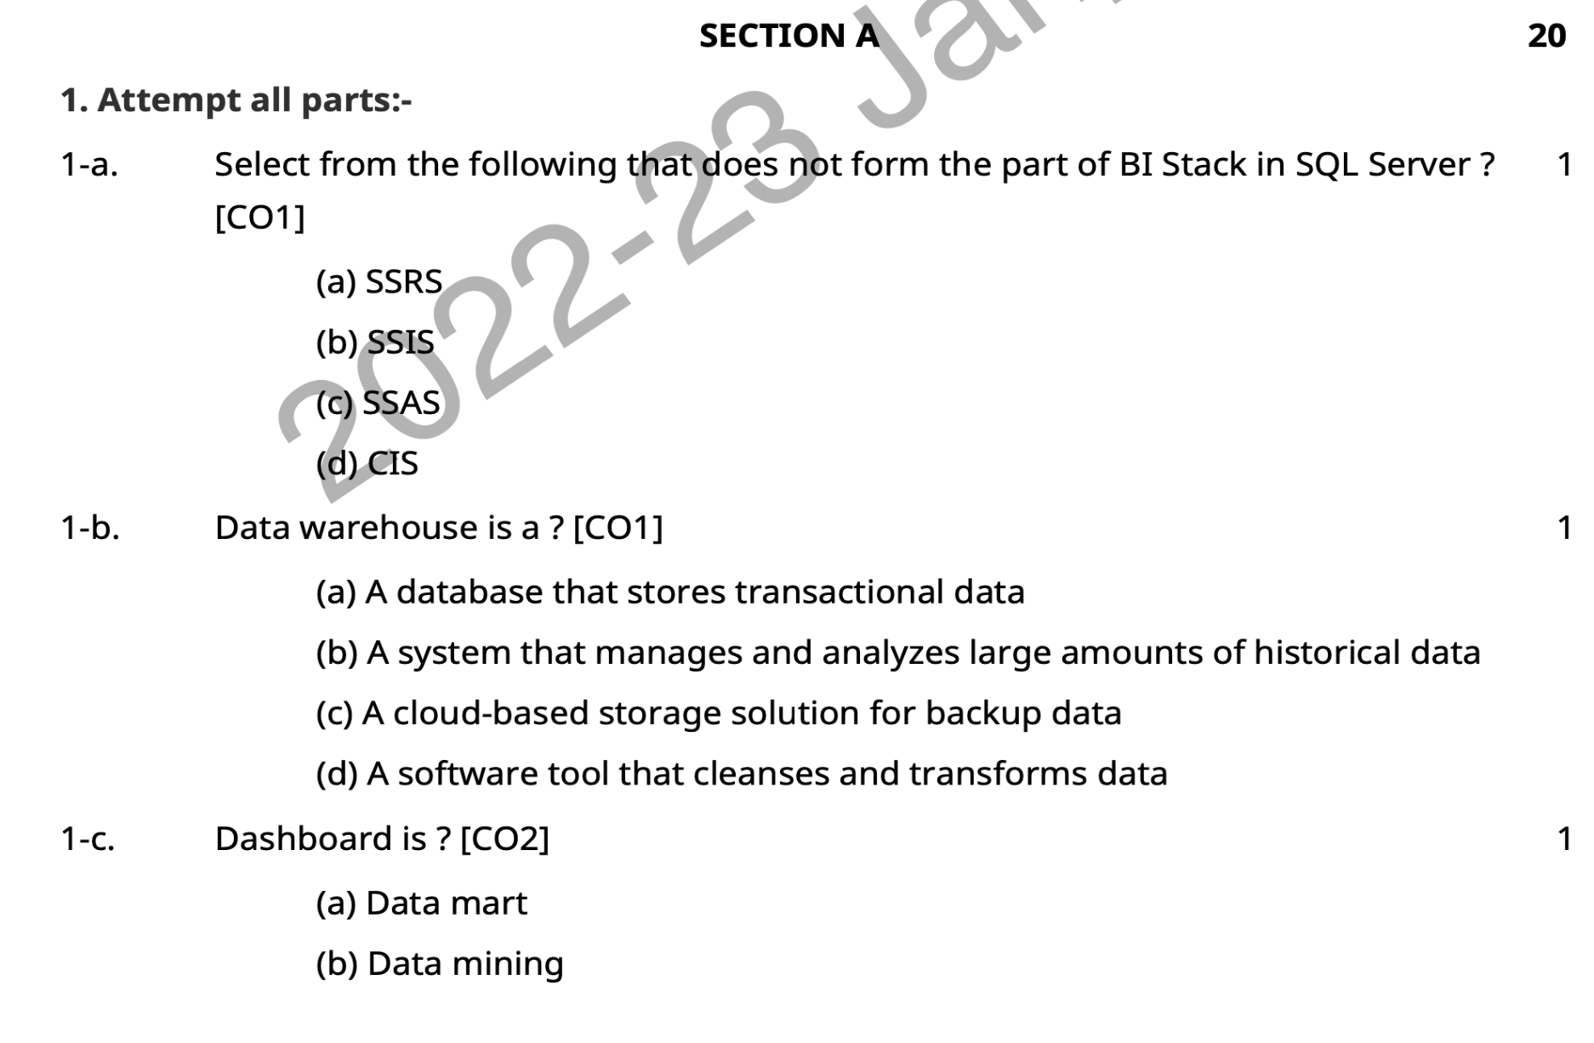
Old Question Papers

Slide 59
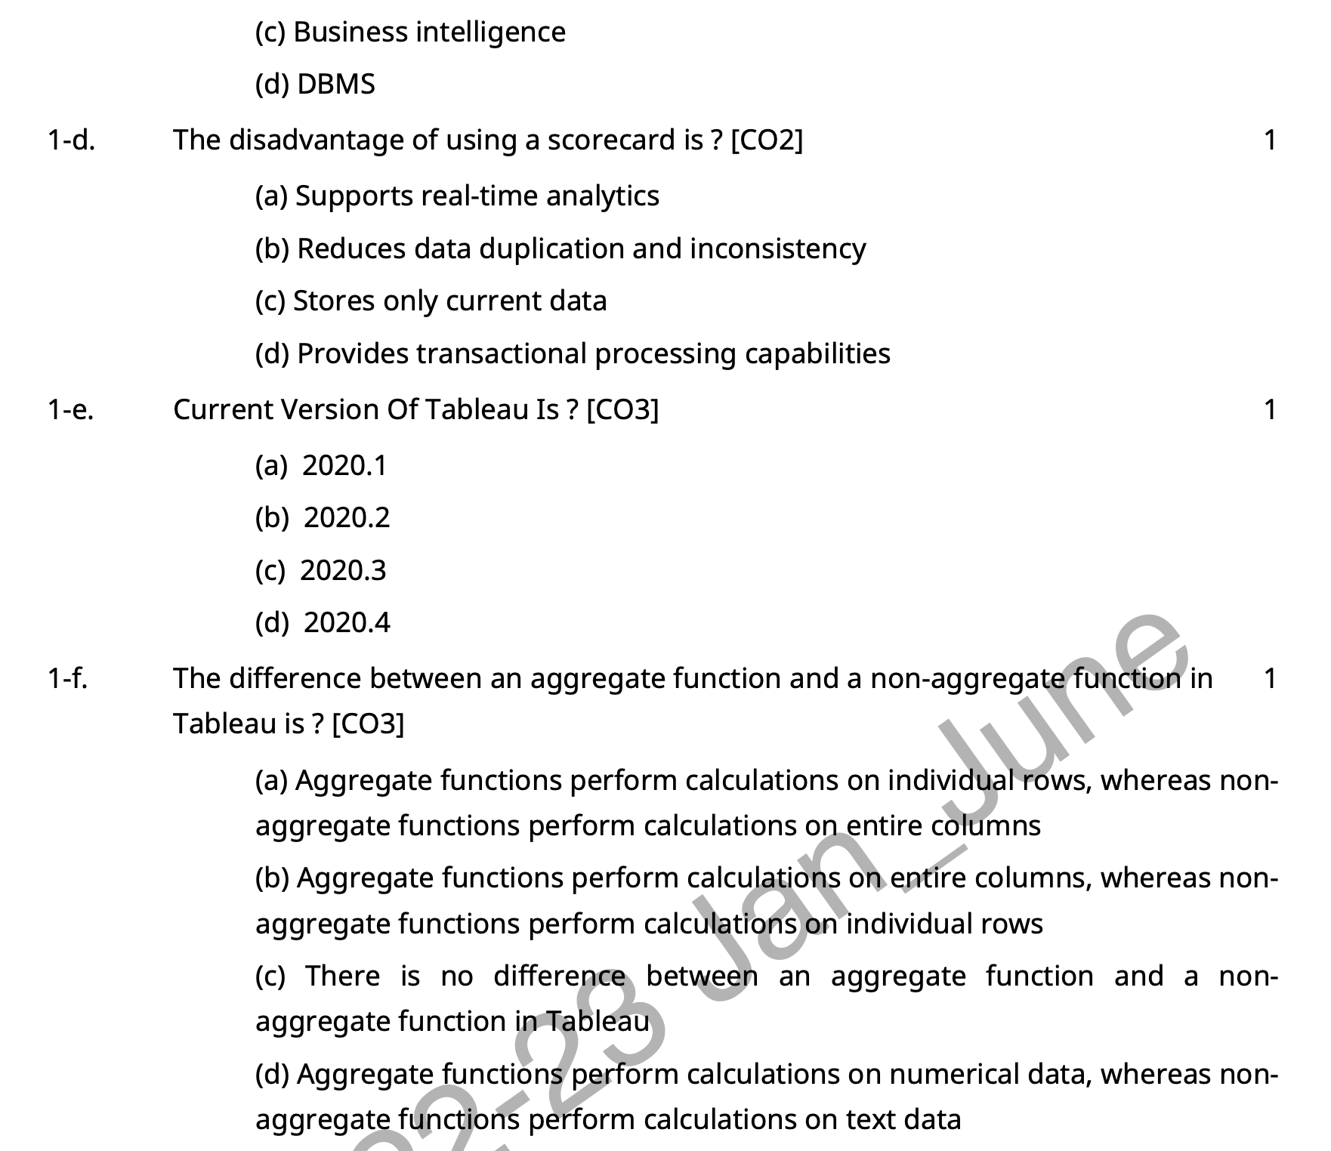
Old Question Papers

Slide 60
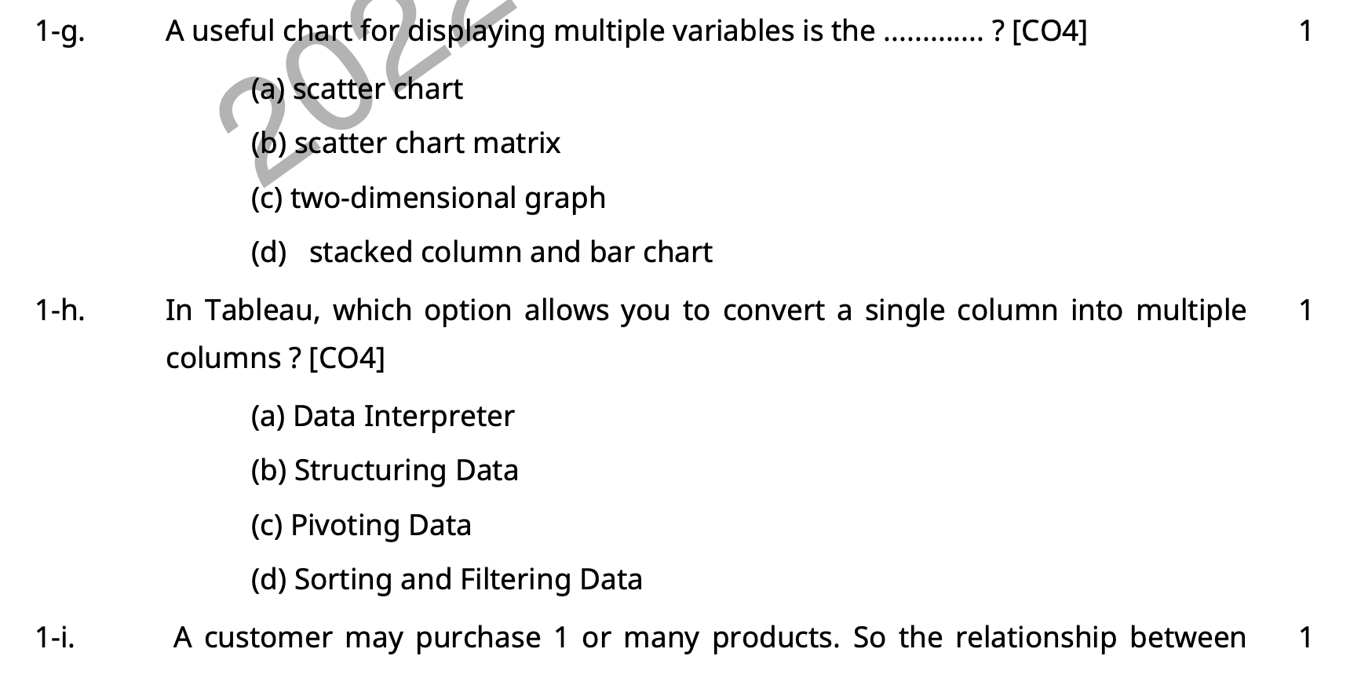
Old Question Papers

Slide 61
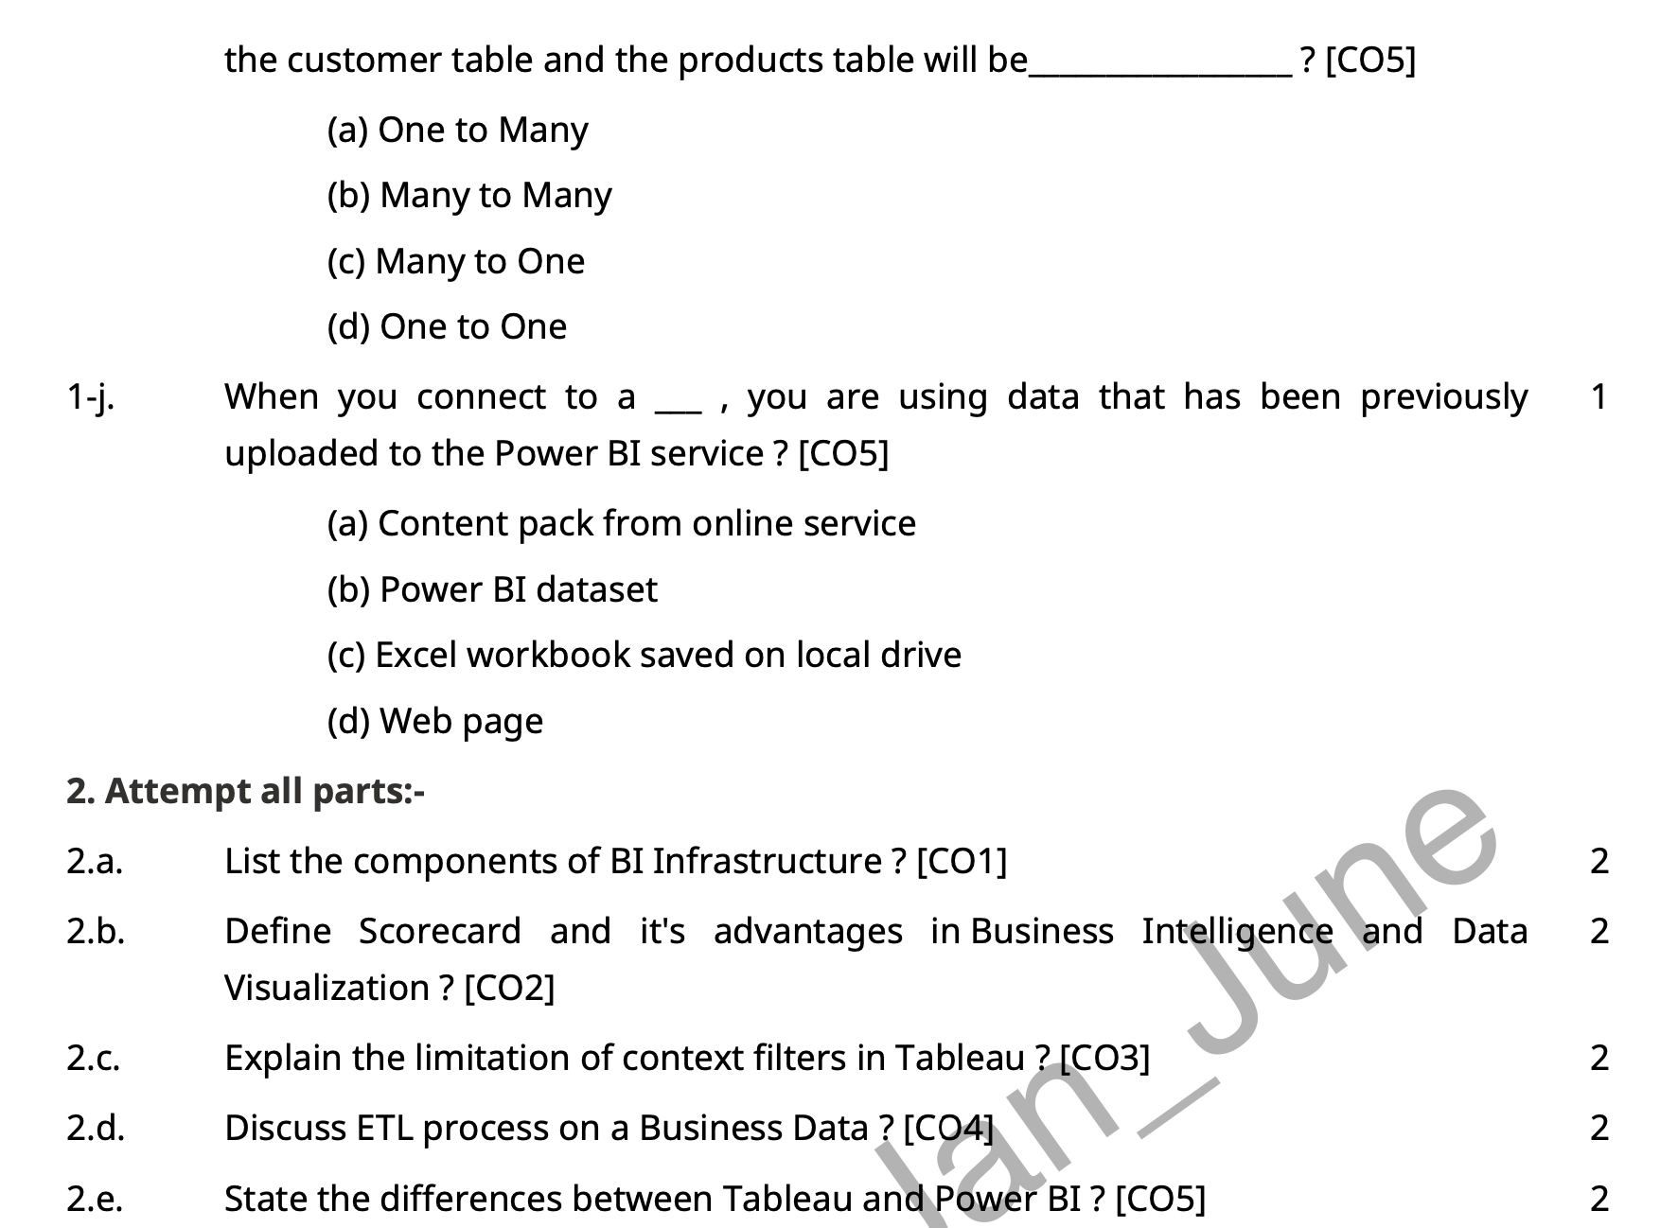
Old Question Papers

Slide 62
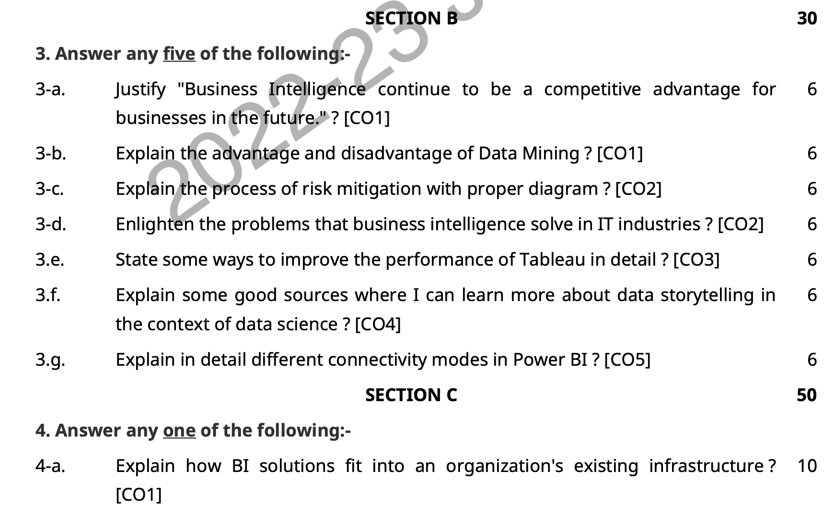
Old Question Papers

Slide 63
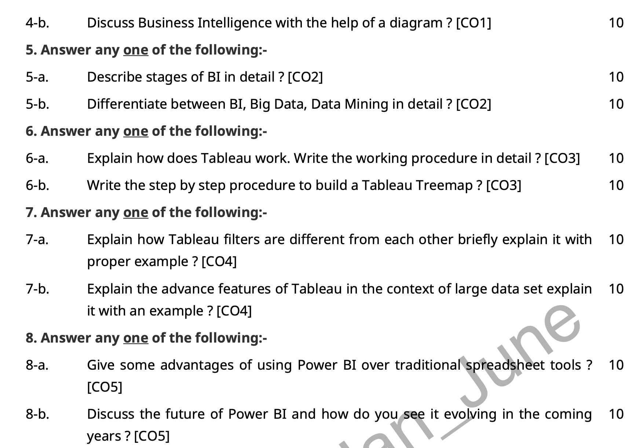
Old Question Papers

Slide 64
References
Thank You

